Slide 1
GITHUB COPILOT PROBLEM STATEMENT
Weather Forecasting Tool (Python) :
Create a command-line tool that accepts a city's name and returns the current weather forecast. Leverage OpenWeatherMap API to fetch weather data and parse it using Python. Your solution should demonstrate how GitHub Copilot can help you with API usage, data parsing, and error handling.

Slide 2
Api in real world
APIs (Application Programming Interfaces) are widely used in the real world across various industries and applications. Here are a few examples of how APIs are utilized:
Social Media Integration: APIs provided by social media platforms like Facebook, Twitter, and Instagram allow developers to integrate social media functionalities into their applications. This includes features like posting updates, retrieving user information, and interacting with social media content.
Payment Gateways: Payment service providers like PayPal, Stripe, and Braintree offer APIs that enable developers to integrate secure payment processing into their applications. These APIs allow users to make payments, handle transactions, and manage billing details.
Mapping and Geolocation: APIs such as Google Maps, Mapbox, and OpenStreetMap provide developers with access to mapping and geolocation services. This enables applications to display maps, calculate routes, geocode addresses, and perform location-based searches.

Slide 3
Api in real world (Contd.)
Weather Data: Weather APIs like OpenWeatherMap and AccuWeather allow developers to retrieve weather data for specific locations. This data can be used in applications such as weather forecasts, outdoor activity planning, and climate analysis.
Cloud Services: Cloud providers like Amazon Web Services (AWS), Google Cloud Platform (GCP), and Microsoft Azure offer a wide range of APIs for services such as storage, computing, database management, AI/ML, and more. These APIs enable developers to leverage cloud resources and build scalable applications.
Communication and Messaging: APIs from providers like Twilio and Nexmo facilitate integration of communication features into applications, including SMS, voice calls, video calls, and chat messaging.
Financial Services: APIs provided by banks and financial institutions allow developers to access banking services, perform transactions, retrieve account information, and manage finances securely.
These are just a few examples, but APIs are utilized in countless other domains, including e-commerce, healthcare, IoT (Internet of Things), travel, music streaming, and more. APIs play a crucial role in enabling interoperability and enabling developers to leverage external services and data to enhance their applications' functionality and user experience.

Slide 4
Example of Api Endpoint
Endpoint:
GET /api/users/{user_id}
This endpoint allows you to retrieve information about a specific user by providing their user ID as a parameter. The "GET" method indicates that you are making a request to retrieve data from the server.
Example Request: GET /api/users/123456
Example Response: HTTP/1.1 200 OK Content-Type: application/json
{ "user_id": "123456", "name": "John Doe", "email": ojohn@example.com", "age": 30, "location": "New York" }
In this example, the API endpoint "/api/users/{user_id}" retrieves user information based on the provided user ID. The server responds with a JSON object containing details such as the user's name, email, age, and location.
Please note that this is a simplified example, and real-world API endpoints can vary significantly based on the specific API and its functionality. The actual structure, parameters, and response format of an API endpoint depend on the API's design and the requirements of the application or service it supports.

Slide 5
Data Parsing
Data parsing refers to the process of extracting relevant information from a raw data source and converting it into a structured format that can be easily understood and processed by a computer or application. The specific parsing method and techniques used depend on the type of data being parsed and the desired output format.
Here are some common techniques and formats used for data parsing:
1. JSON Parsing: JSON (JavaScript Object Notation) is a popular data interchange format. JSON parsing involves extracting data from a JSON string and converting it into objects or data structures that can be used within a program. Most programming languages provide built-in functions or libraries for parsing JSON.
2. XML Parsing: XML (eXtensible Markup Language) is another widely used format for storing and exchanging structured data. XML parsing involves reading an XML document and extracting relevant data elements using techniques like DOM (Document Object Model) parsing or SAX (Simple API for XML) parsing.
3. CSV Parsing: CSV (Comma-Separated Values) is a plain text format commonly used for storing tabular data. CSV parsing involves splitting the data into rows and columns and extracting the necessary information. Programming languages often provide functions or libraries to parse CSV files easily.
4. Regular Expressions: Regular expressions (regex) are powerful tools for pattern matching and data extraction. They allow you to define search patterns and retrieve specific data based on those patterns. Regular expressions can be used to parse various types of data, including text, log files, and structured formats.

Slide 6
Data Parsing (Contd.)
5. HTML Parsing: HTML (Hypertext Markup Language) is the standard markup language for creating web pages. HTML parsing involves extracting data from HTML documents, such as scraping information from web pages or extracting specific elements from an HTML source using libraries like Beautiful Soup or XPath expressions.
6. Binary Data Parsing: Binary data parsing is used when dealing with binary file formats or protocols. It involves interpreting the binary data according to the defined structure or protocol specification. This can be done using low-level programming techniques or libraries specifically designed for parsing binary data.
The choice of parsing technique depends on the data format, programming language, and libraries available. Different parsing methods have their own advantages and considerations, such as performance, complexity, and error handling. It's important to understand the structure and requirements of the data you're parsing to choose the appropriate parsing technique and ensure accurate and reliable extraction of the desired information.

Slide 7
Error Handling
Error handling is a critical aspect of software development and involves managing and responding to errors or exceptional conditions that occur during the execution of a program. Effective error handling helps ensure that a program can gracefully handle unexpected situations, provide meaningful feedback to users, and prevent unexpected crashes or data corruption.
Here are some key considerations for error handling:
1. Error Types and Categories: Identify and categorize the types of errors that can occur in your program. Common error categories include syntax errors, logic errors, runtime errors, input validation errors, network errors, and resource-related errors. Categorizing errors helps determine appropriate error-handling strategies.
2. Exception Handling: Exception handling is a widely used approach for managing errors. Exceptions are special objects that represent exceptional conditions or errors. When an error occurs, an exception is raised, and the program flow can be redirected to handle the exception. Exception handling typically involves try-catch blocks or similar constructs, where potential error-causing code is placed within a try block, and specific exception types are caught and handled in catch blocks.
3. Error Reporting and Logging: Implement mechanisms to report and log errors. When an error occurs, provide meaningful error messages or codes that can help users or developers understand the issue. Log errors, including relevant details such as timestamps, error descriptions, stack traces, and contextual information, to aid in debugging and troubleshooting.
4. Graceful Degradation and Recovery: Consider how your program can gracefully degrade or recover from errors. For critical operations or resources, implement mechanisms to handle errors and ensure the program remains in a stable state. This may involve rolling back transactions, releasing resources, retrying operations, or providing fallback alternatives.

Slide 8
Error Handling (Contd.)
5. Error Propagation and Wrapping: When developing libraries or modules, decide how to handle and propagate errors to higher-level code. Consider wrapping lower-level exceptions with custom exceptions that provide more context and abstraction. This helps maintain separation of concerns and allows error handling code to be tailored to specific use cases.
6. Input Validation and Sanitization: Validate and sanitize user inputs to prevent errors or security vulnerabilities. Implement appropriate checks and constraints to ensure that inputs conform to expected formats, ranges, or constraints. Validate and sanitize inputs from external sources, such as user input, API requests, or file uploads, to prevent potential security risks like injection attacks or buffer overflows.
7. Documentation and Error Messages: Provide clear and helpful documentation regarding potential errors, their causes, and possible solutions. Design informative error messages that assist users or developers in understanding the problem and taking appropriate action.

Slide 9
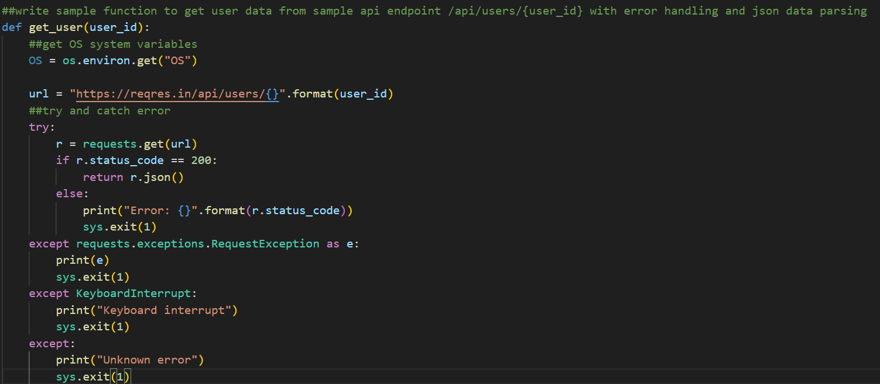
For example:

Slide 10
Github Copilot
GitHub Copilot is an AI-powered code completion tool developed by GitHub in collaboration with OpenAI. It is designed to assist developers in writing code by providing suggestions and autocompletions based on the context of their code and learned patterns from a vast codebase.
GitHub Copilot integrates as an extension within the Visual Studio Code (VS Code) editor, a popular and widely used code editor. It operates as an intelligent assistant, suggesting code snippets, function implementations, class definitions, variable names, and more, as developers write code in real-time.
Using machine learning models, GitHub Copilot analyzes the code being written and generates context-aware suggestions to accelerate the coding process. It can handle a wide range of programming languages and frameworks, making it useful for various development scenarios.
While GitHub Copilot can significantly boost productivity by reducing manual typing and providing code suggestions, it is important to review and validate the suggestions it provides to ensure correctness and adherence to coding best practices. Developers should maintain their understanding of the code they write and exercise their judgment when incorporating Copilot's suggestions.
GitHub Copilot was launched as a technical preview in June 2021, and the availability, features, and usage of Copilot may have evolved since then. For the most up-to-date information and instructions on how to use GitHub Copilot, I recommend referring to the official GitHub Copilot documentation and the GitHub Copilot website.

Slide 11
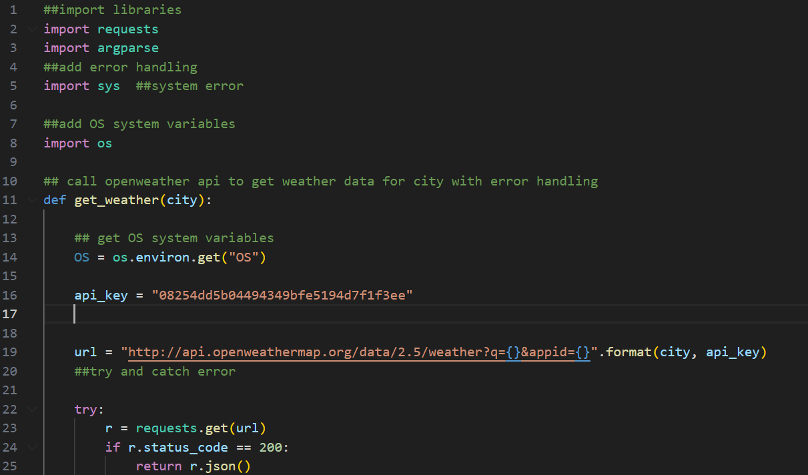
Code generated using Github Copilot

Slide 12
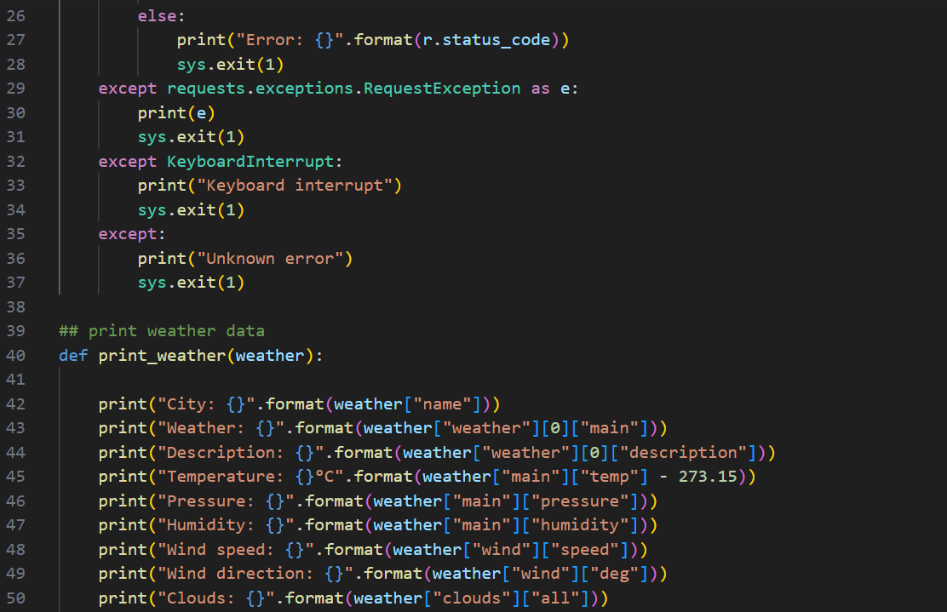
Code generated using Github Copilot (Contd.)

Slide 13
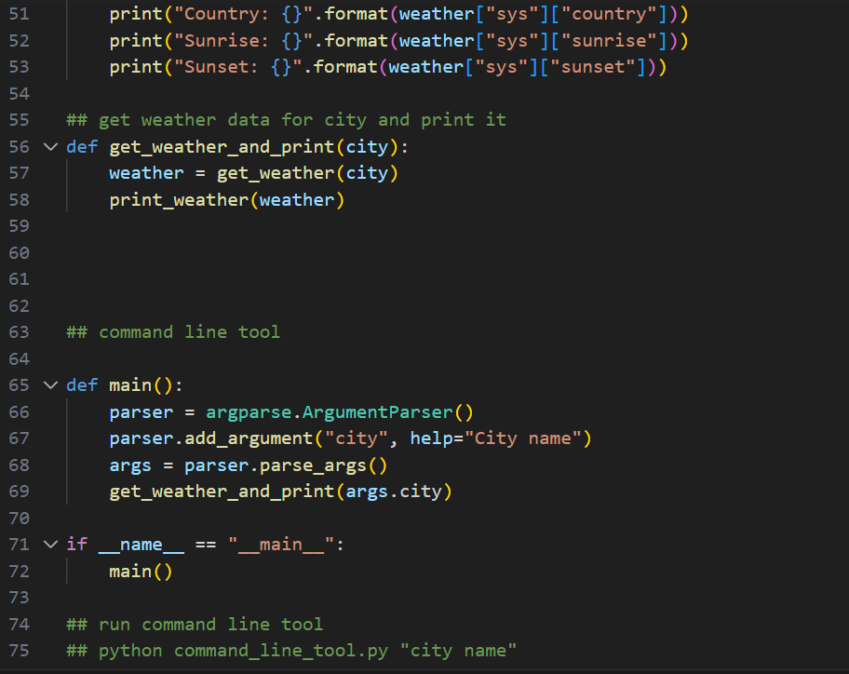
Code generated using Github Copilot (Contd.)

Slide 14

Code generated using Github Copilot (Contd.)

Slide 15
Github Copilot Use Cases:
GitHub Copilot is an AI-powered code completion tool that offers several features to assist developers in writing code efficiently. Here are some notable features of GitHub Copilot:
1. Code Suggestions: GitHub Copilot provides context-aware code suggestions as developers type in the Visual Studio Code editor. It suggests code snippets, function implementations, variable names, and more based on the current code context and learned patterns from a vast codebase.
2. Multilingual Support: GitHub Copilot supports a wide range of programming languages, including popular languages like Python, JavaScript, TypeScript, Java, C++, Go, and more. It enables developers to benefit from its code suggestions across different languages and frameworks.
3. In-Line Documentation: Copilot provides in-line documentation for suggested code snippets. It includes relevant function signatures, parameter descriptions, and example usages, helping developers understand the purpose and usage of the suggested code.
4. Autocompletion of Statements and Expressions: GitHub Copilot can automatically complete partially written statements or expressions. It analyzes the code context and provides suggestions to complete the code, saving developers time and reducing the need for manual typing.
5. Support for Writing Tests: Copilot can assist in generating test code based on the code you're writing. It suggests test functions, assertions, and test setup code to facilitate the testing process and improve code quality.
6. Integration with Version Control: GitHub Copilot integrates seamlessly with Git and GitHub workflows. It can generate code that aligns with best practices for version control, such as proper commit messages, branch naming conventions, and more.
7. Continuous Learning and Improvement: As developers use GitHub Copilot, they can provide feedback on the suggestions, indicating whether they are helpful or not. This feedback helps train the underlying machine learning models and improves Copilot's accuracy and relevance over time.

Slide 16
Thank You

